Slide 1
Not Enough Wheat Pasture
Paul A. Beck
Rancher’s Thursday Lunchtime Webinar Series
November 4, 2021

Slide 2
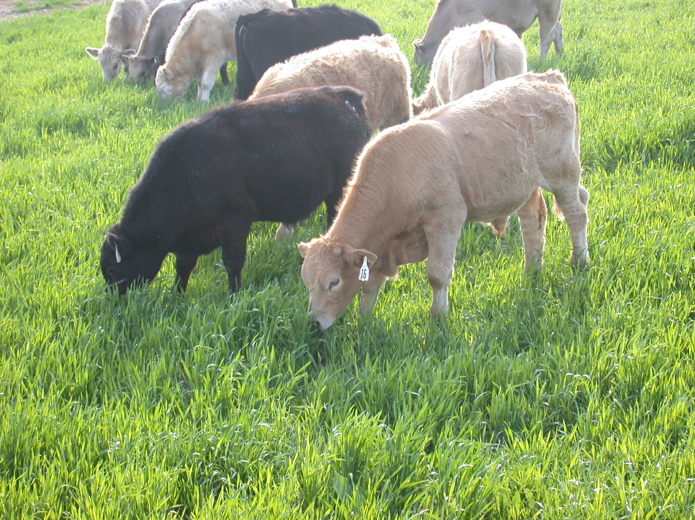
Notes:
Intro slide to Batesville research on clean till planted winter annuals

Slide 3
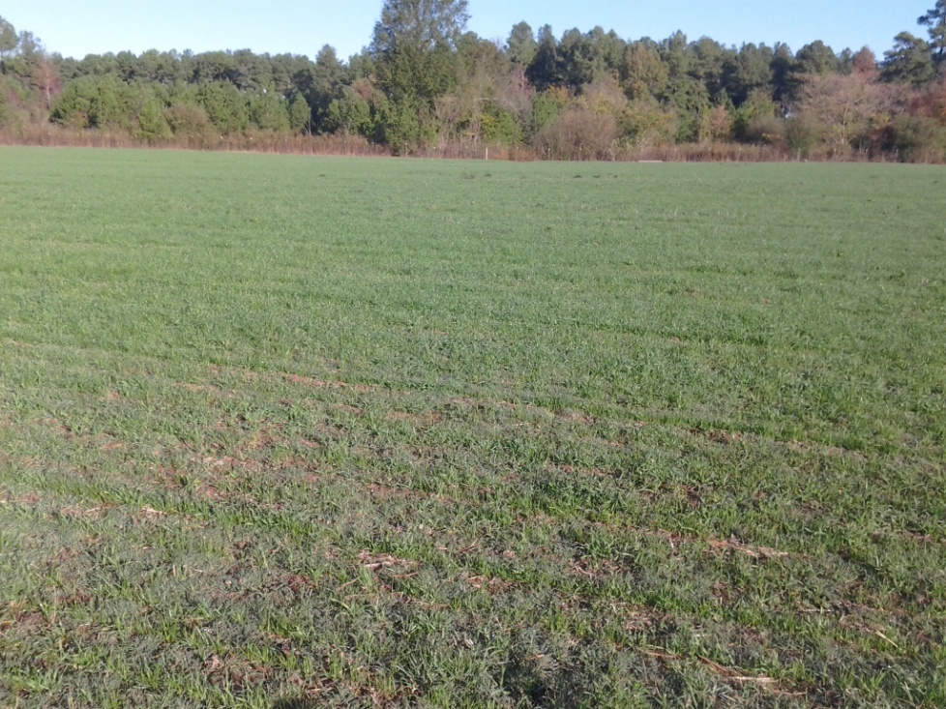
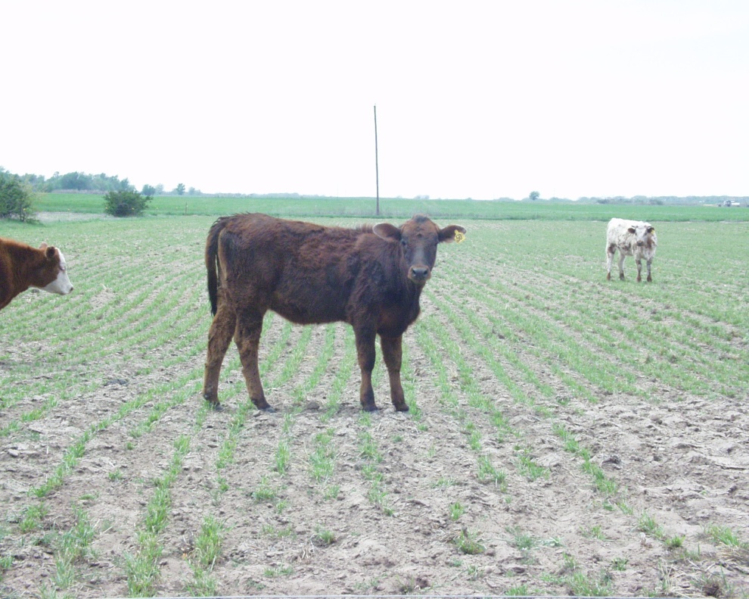
400 lb Forage DM/acre

Slide 4
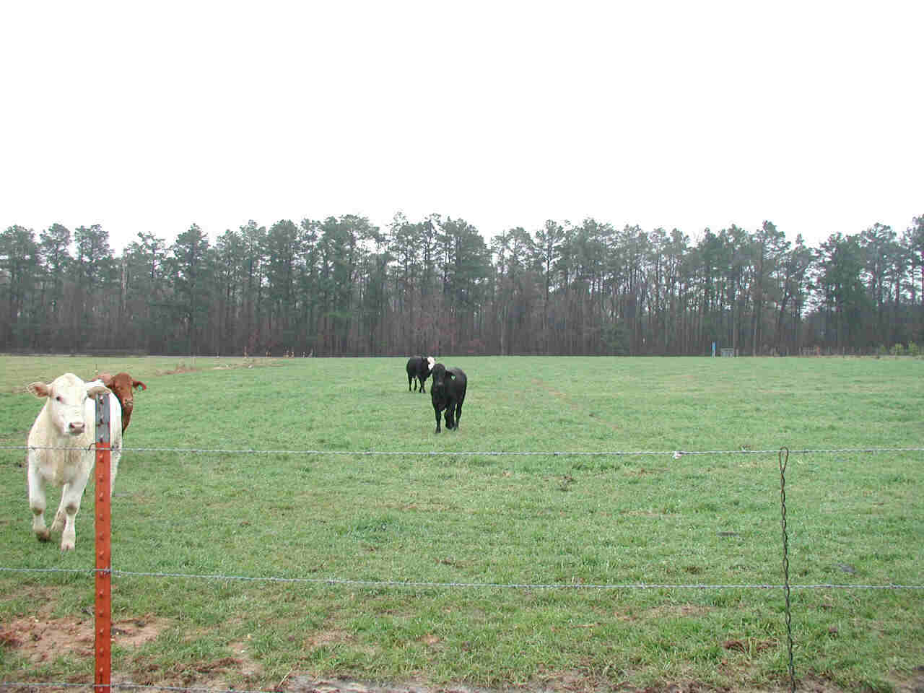
650 lb forage DM/acre

Slide 5
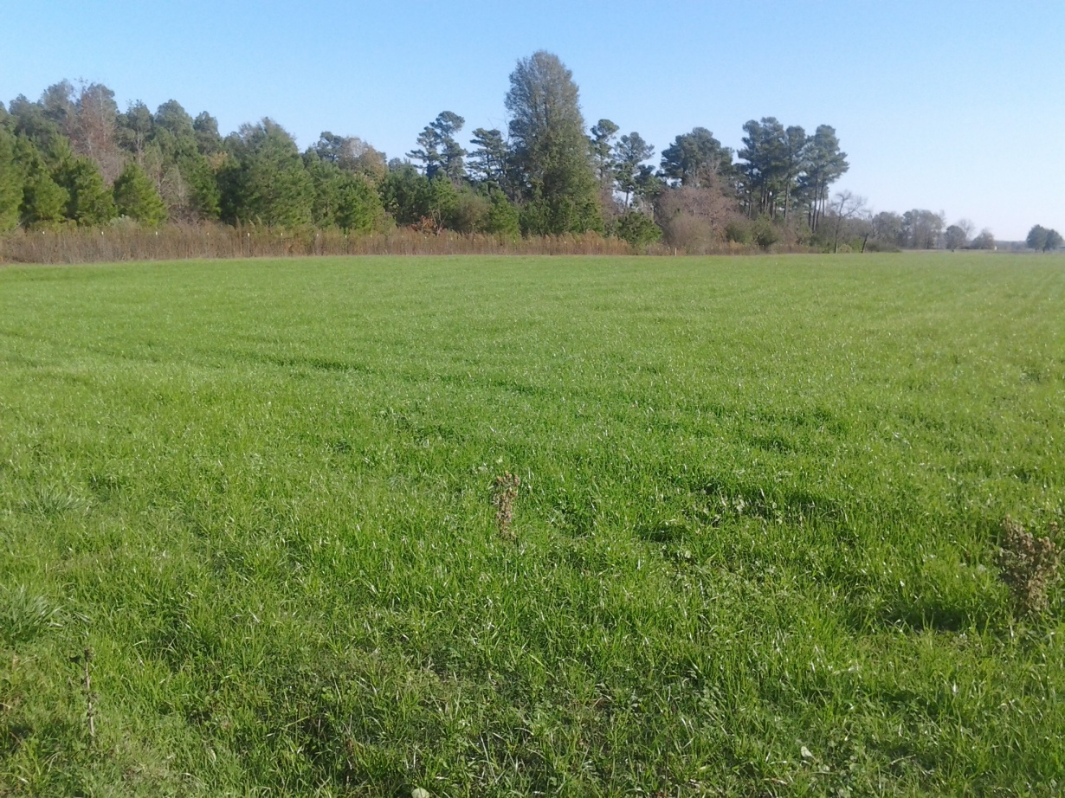

Slide 6
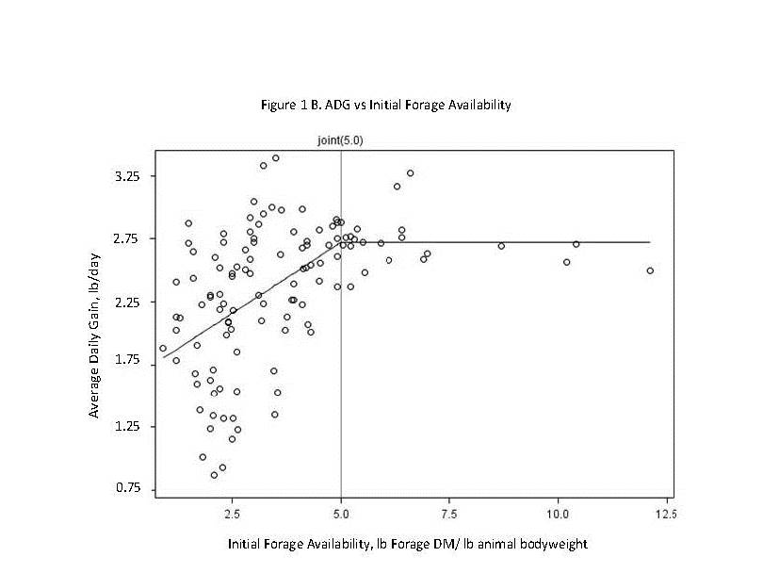

Slide 7
Setting the Correct Stocking Rate
Stocking rate is one of the management decisions with major impact on animal performance.
Forage Allowance (lbs forage DM/lb calf bodyweight)
Allows us to objectively set stocking rate for desired performance.
Our research indicates that 2.5 to 5 lbs forage DM/ lb calf BW should allow for ADG of 2 to 2.5 lbs/d.
1,000 to 2,000 lbs of forage DM/400 lb calf
Need to also have 900 to 1,200 lbs of forage DM/acre
What does this look like? 200 lb/acre per inch…
5 to 6 inches or taller.

Slide 8
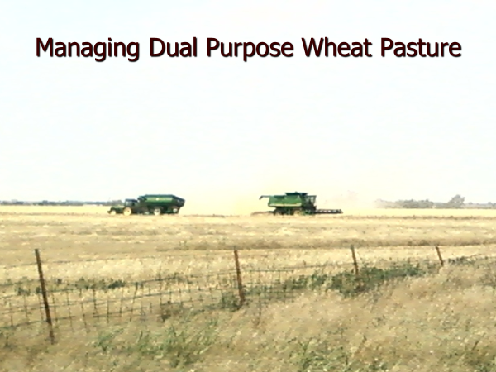

Slide 9
Managing Dual Purpose Wheat Pasture
Compare two 1,600 acre farms in NW Texas (Bevers, 2008)
Harvest all wheat as grain with no grazing
Dual purpose wheat with partial grazeout (500 acres)
 | Grain only | Dual purpose | Stocker cattle
Gross Return,$ | 470,630 | 343,710 | 754,951
Direct Costs, $ | 302,155 | 227,885 | 640,276
Indirect Costs, $ | 71,128 | 52,905 | 16,000
Net Returns,$ | 97,348 | 62,921 | 98,676
Wheat plus Cattle |  | $161,597

Slide 10
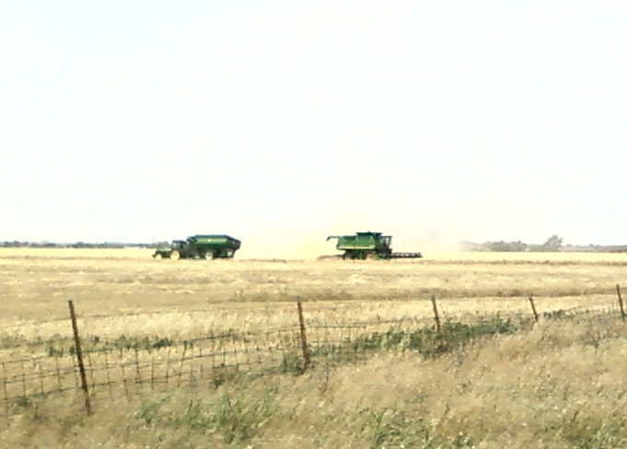
Managing Dual Purpose Wheat Pasture
Planting date has effects on both forage and grain yield
Grazing can have both positive and negative affect on grain yield.
Key to success is removal of cattle at the first hollow stem of development in wheat

Slide 11
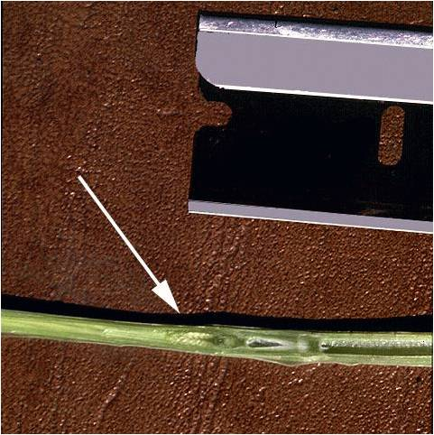
First Hollow Stem
From: Trostle and Bean, 2003, Texas AgriLife Extension

Slide 12
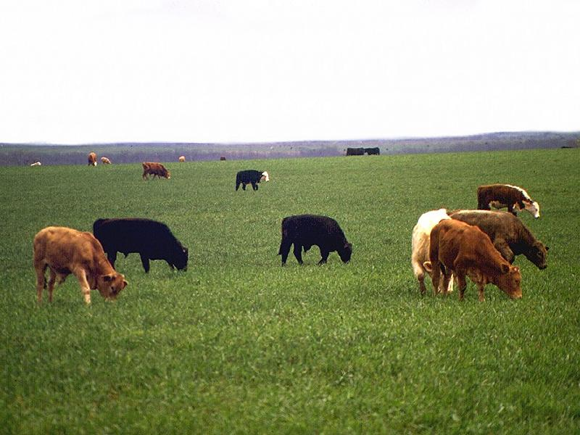
Oklahoma Studies
Hard red winter wheat planted on September 3-4 or September 25-26
Late planting delayed steer turnout by 1 month and decreased grazing days by 24
Decreased steer gain by 88 lbs
Increased grain yield by 10 bushel/acre (39 vs 49 bu/acre)

Slide 13
Grazing Termination

Slide 14
Duration of Grazing
Calves have been observed to lose BW for up to 2-weeks when turned out on wheat pasture.
Reached initial BW after 20-days
BW increase of only 23 pounds by 30-day
Steers gained 100 pounds in next 30-days
If pulling calves off for grain production
FHS of early varieties much earlier than “historic” rule of thumb or March 15
Delays in turnout of steers may lead to disappointing performance that does not meet expectations.

Slide 15
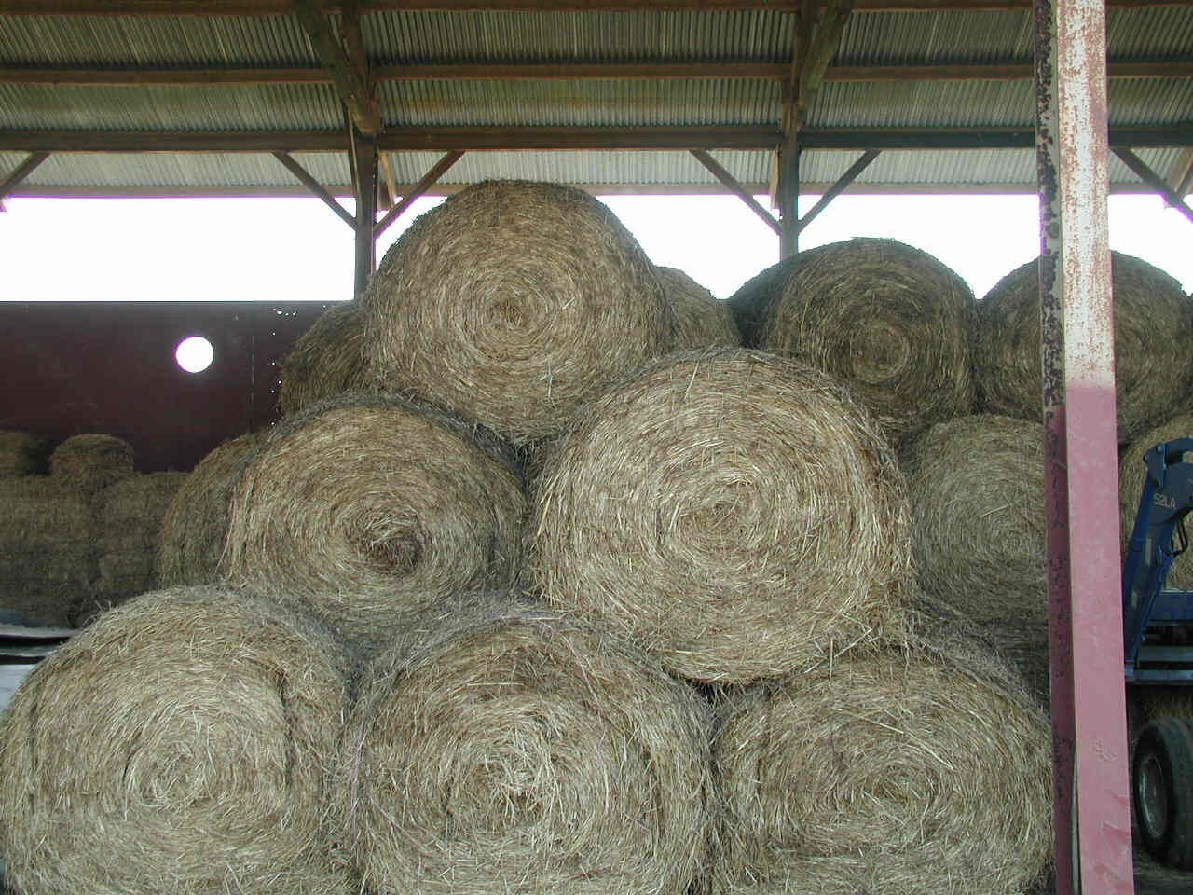

Slide 16
Stocking Rate and Supplementation
2 year study with short wheat pasture
500 to 700 pounds per acre at turnout
Hay offered free-choice
10% CP & 55% TDN
Stocked at 2 acres per steer with no or 3.5 lbs/day soybean hulls
Stocked at 1.33 acres per steer with 3.5 or 5.25 lbs/day soybean hulls

Slide 17
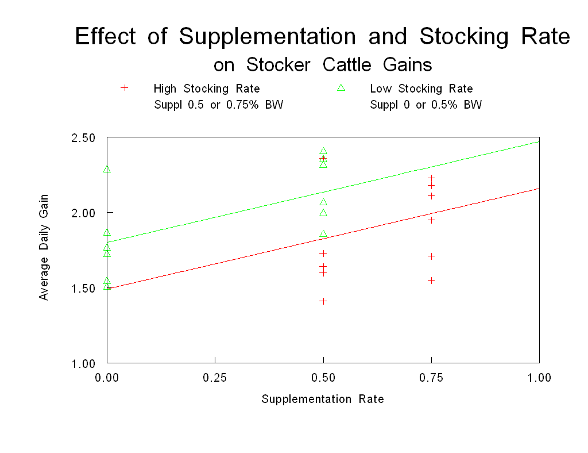
8.8 lb F:G
2.14 lb/d
1.80 lb/d
1.99 lb/d
4.7 lb F:G/ac
5.6 F:G/ac

Slide 18
Feeding Silage to Steers on Wheat
Steers stocked at 2.2 acres per steer with no supplemental silage vs
2.2, 1.6, or 1.1 acres per steer with free-choice access to sorghum or corn silage fed daily.
(Gary Vogel, MS Thesis)

Slide 19
Increasing SR and Silage in OK

Slide 20
Increasing SR and Silage in OK

Slide 21
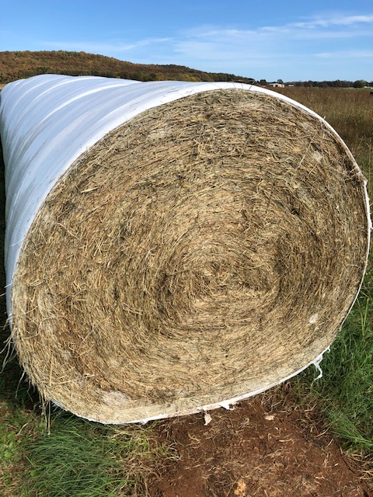
Silage Feeding on Wheat Pasture
12 – 4 acre wheat fields with 2,500 lbs forage DM/acre
Stocked with 566 lb stocker steers at 1 steer/acre
2,500 lbs forage/steer (4.4 lbs forage/lb steer bodyweight)
6 – 4 acre wheat fields with 1,800 lbs forage DM/acre
Stocked with 577 lb stocker steers at 1.5 steers/acre
1,200 lbs forage/steer (2.1 lbs forage/lb steer bodyweight)
Fed free-choice bermudagrass round bale silage
49% DM, 14% CP & 56% TDN

Slide 22
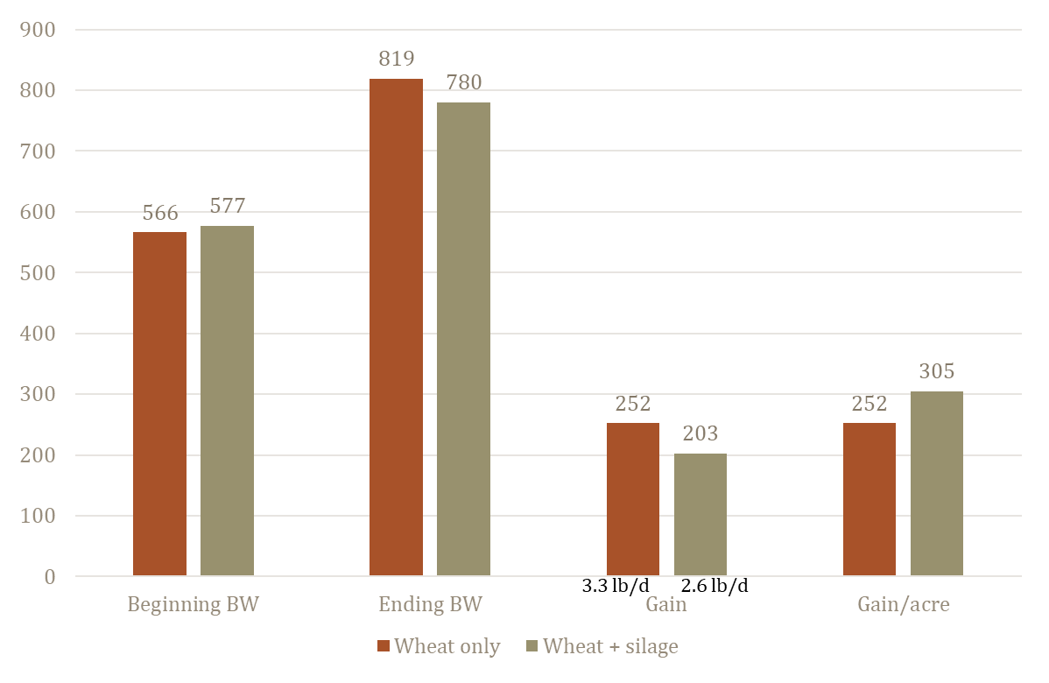
Silage feeding on wheat

Slide 23
Designed Experiment
Determine effects of ad libitum access to moderate quality bermudagrass round-bale silage and increasing stocking rate on performance of growing steers grazing wheat pasture.
 | Control | H1x | H1.5x | H2x
Steers/acre Fall Spring | 1.0 2.25 | 1.0 2.25 | 1.5 3.37 | 3.0 4.5
Haylage | N | Y | Y | Y

Slide 24
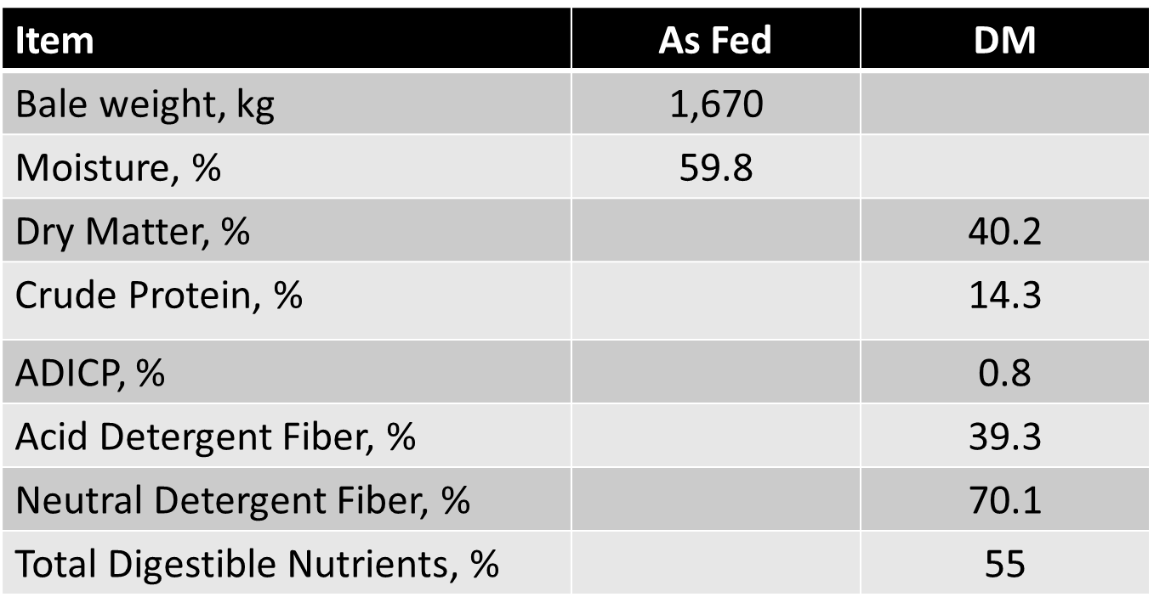
Materials and Methods
Cattle
Fall: n = 98, BW = 540 lbs
Oct 24 to Feb 11 (110 days)
Spring: n = 162, BW = 620 lbs
Control: Feb 27 to Mar 27; Apr 9 to Apr 30 (48 days)
Haylage: Feb 27 to Apr 23 (55 days)

Slide 25
Animal Performance
Item | Control | H1x | H1.5x | H2x
Fall
ADG, lbs/day | 3.08c | 2.94c | 2.53b | 2.11a
Grazing-d/acre | 110a | 110a | 165b | 220c
Gain/acre | 321a | 299a | 411b | 460c
Silage offered, lbs DM/ac | - | 147 | 277 | 473
Spring
ADG, lbs/day | 1.43a | 2.02b | 1.56a | 1.83b
Grazing-d/acre | 108a | 120b | 120b | 123b
Gain/acre | 153a | 240b | 185ab | 223b
Silage offered, lbs DM/ac | - | 180 | 359 | 342

Slide 26
Total Gain and Silage Offered/ acre
lbs Silage DM/lbs added gain 3.0 4.4 3.5

Slide 27
Conclusions
Stocking rate in the fall can be doubled by offering silage bales ad libitum.
31% decrease in ADG
53% increase in gain per acre
Spring ADG not impacted by silage
Reduced impact of grazing on stand
less increase in grazing days
Total Gain per Acre increased 51%
With stocker value of gain = $1.12/lb
Silage bale would need to be valued at $0.17/pound to break even.

Slide 28
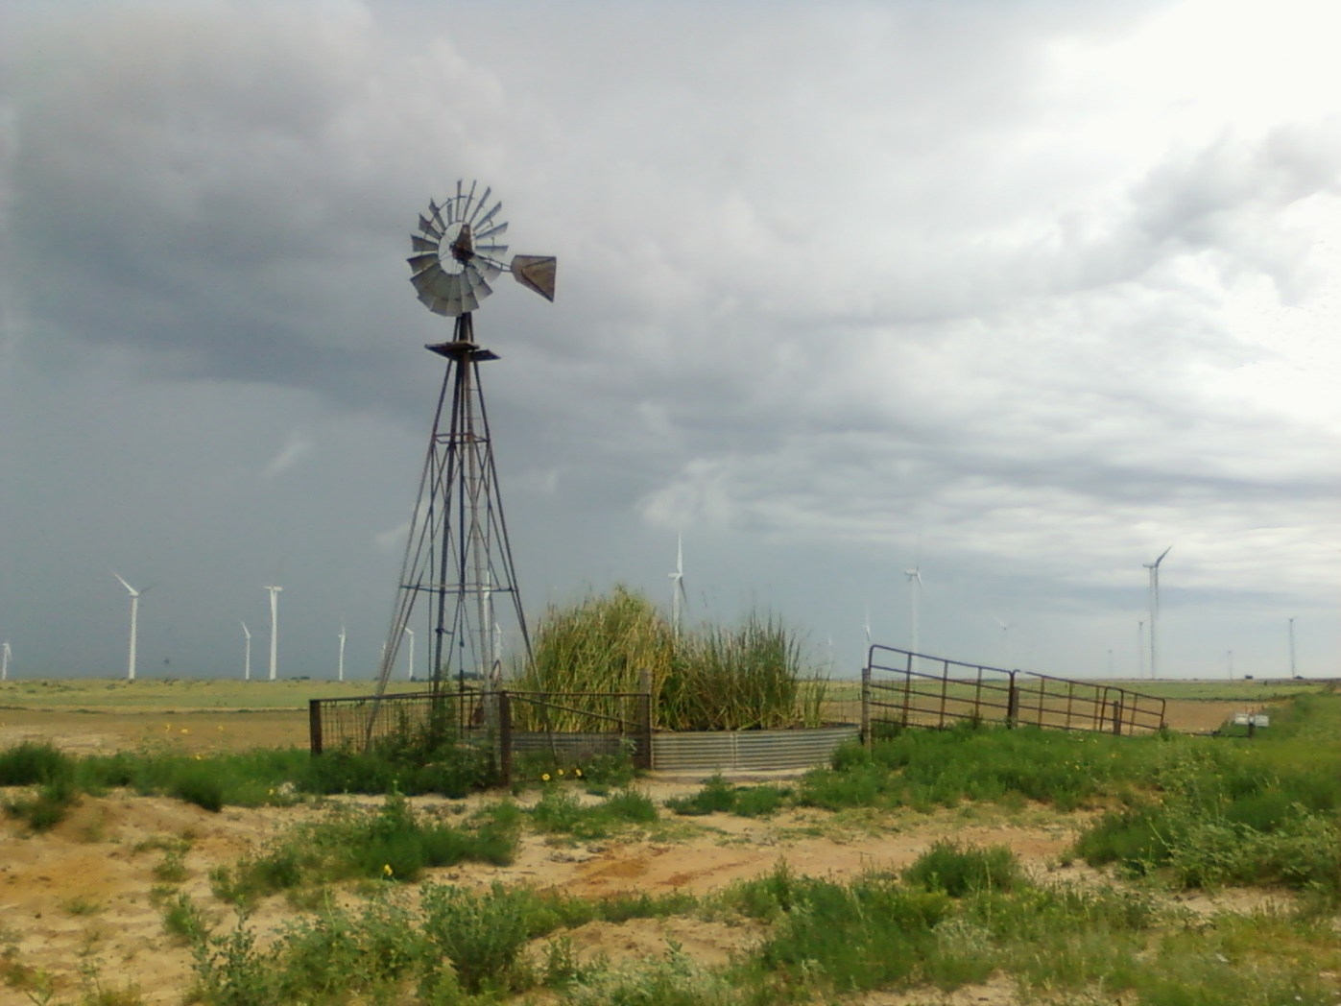
Questions?

